Slide 1
Health Awareness and Nutrition
Physical Fitness and Health
Department of Clinical Nutrition and Dietetics
College of Health Sciences

Slide 2

Physical Activity
Any bodily movement produced by skeletal muscles that require energy expenditure.
Doing physical activity at a moderate and regular pace for a certain period of time every day and for five days a week to maintain and improve health.
Walking, cycling, swimming or playing sports has significant benefits for health.
It can decrease the risk of a hip fracture and help control weight.

Slide 3

Benefits of Physical Activity
Reduces the risk of high blood pressure, diabetes and depression
Improves bone health
Contributes beneficially to energy expenditure and thus enables energy balance and weight control to be achieved
Can be practiced in almost all places and does not require specific equipment
Carrying household items or books, climbing stairs, or washing the car are good activities

Slide 4
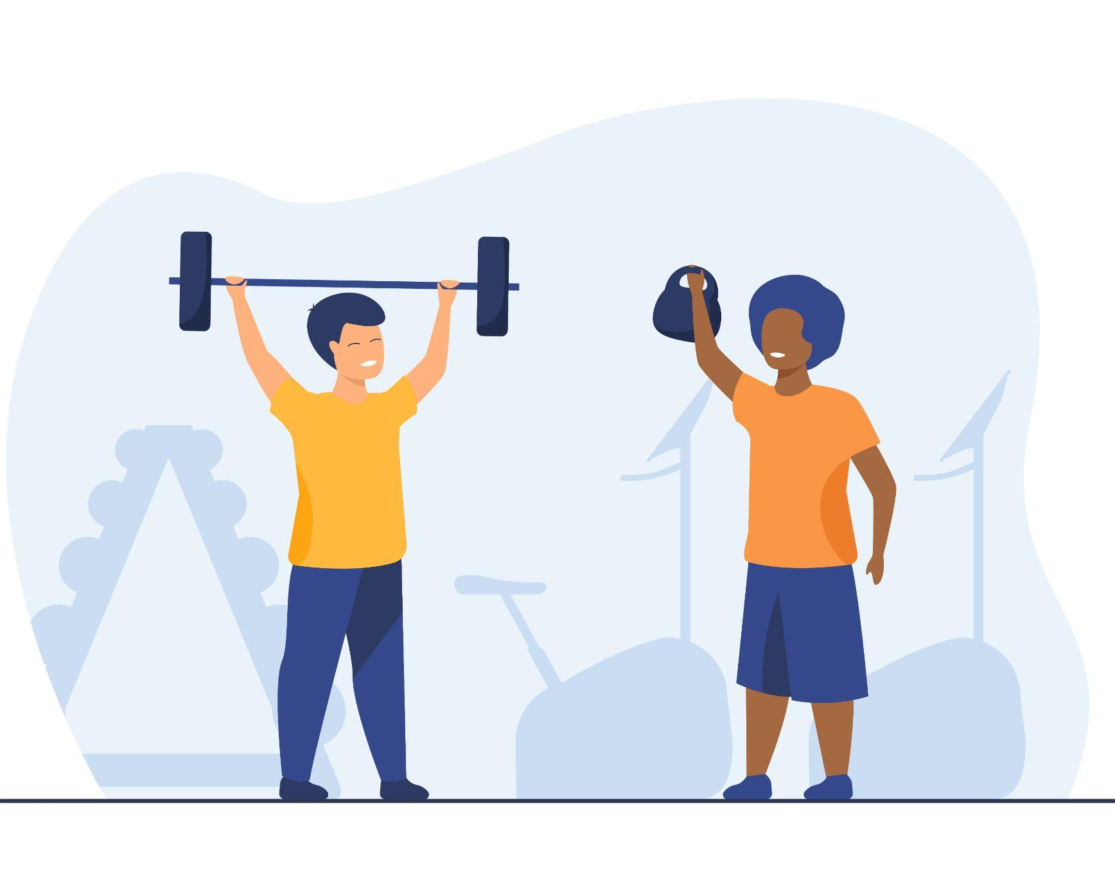
Physical Fitness
The state or condition of being fit.
The basic elements of physical fitness are speed, strength, agility, endurance and balance.
Good health as the result of exercise and proper nutrition.
You are able to perform physical activity.
You have the energy and strength to feel as good as possible.

Slide 5

Benefits of Physical Fitness
Improved sleep
Improved digestion
Optimal body composition (less fat)
Healthier bones and higher bone density
Increased immunity and and resistance to colds and other infectious diseases
Lower risk of some types of cancers
Strong circulation and lung function
Lower risk of cardiovascular disease
Lower risk of diabetes
Lower risk of gallbladder disease in women
Lower incidence and severity of anxiety and depression
Higher self-confidence
Long and healthy life ahead

Slide 6
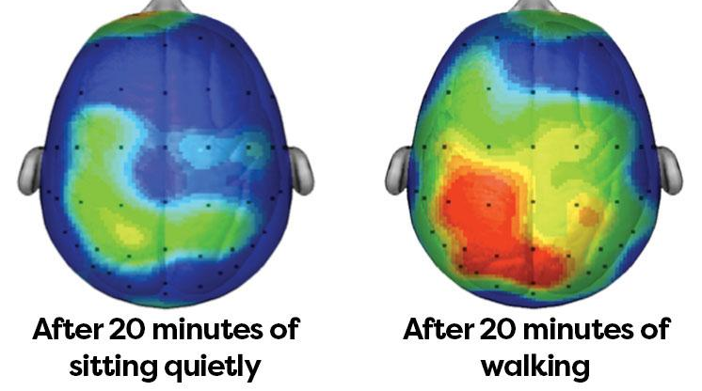
Exercise and Your Brain
When you exercise, your heart rate increases and your body pumps more oxygen to your brain. A well-oxygenated brain helps manage anxiety and depression.
After 20 or 30 minutes of aerobic exercise your body releases chemicals called endorphins that interact with receptors in your brain and reduce your perception of pain—meaning you're more likely to feel positive and upbeat during a tough workout.
It also releases other mood-enhancing chemicals like serotonin and dopamine that can stick around in your brain for a couple of hours after you exercise.

Slide 7
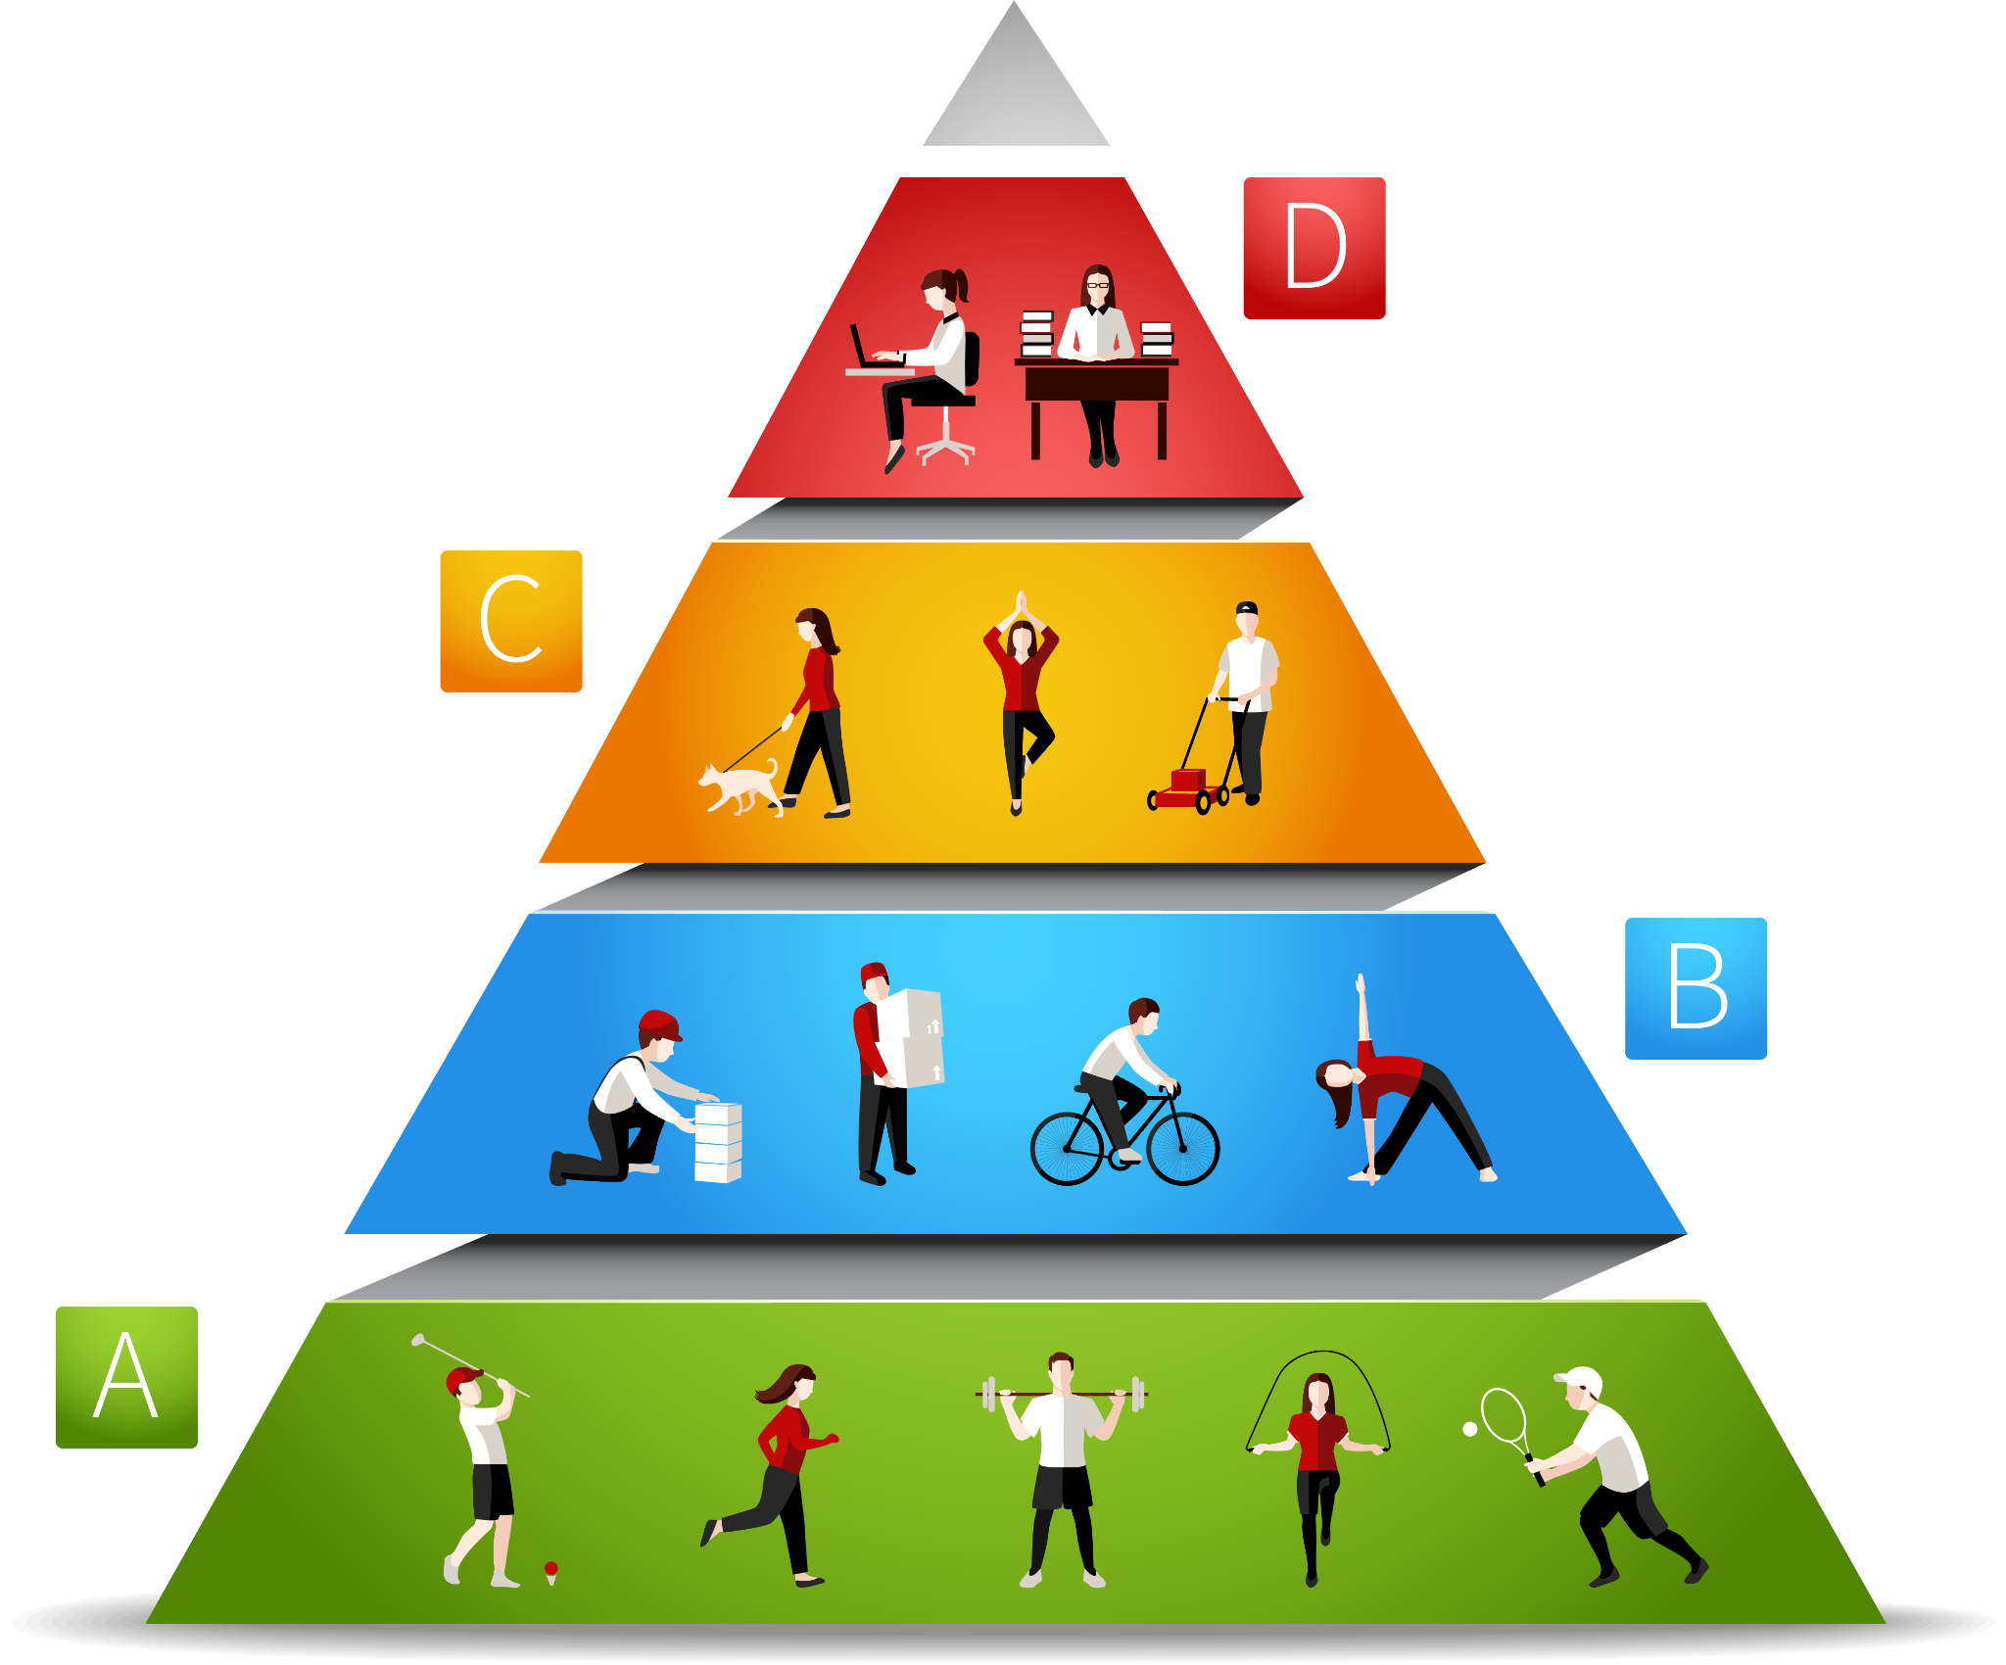
Physical Activity Pyramid
EVERY DAY–
Be as active as possible.
Use the stairs
Walk or bike to class, work, or shops
Scrub floors, wash windows
Walk your dog
Mow grass, rake leaves, turn compost, shovel snow, tend garden
Wash and wax your car
Play with children
DO SPARINGLY–
Limit sedentary activities.
Watching TV, videos or movies
Playing computer games
3-5 DAYS/WEEK–
Engage in vigorous activities regularly.
Aerobic activities such as running, biking, swimming, roller-blading, rowing, cross-country skiing, kickboxing, power walking, dancing, jumping rope
Sports activities such as basketball, soccer, volleyball, tennis, football, racquetball, softball
2-3 DAYS/WEEK–
Engage in strength and flexibility activities and enjoy leisure activities often.
Sit-ups, push-ups
Strength training such as weight lifting
Stretching exercises such as yoga
Leisure activities such as canoeing dancing, golfing, horseback riding

Slide 8
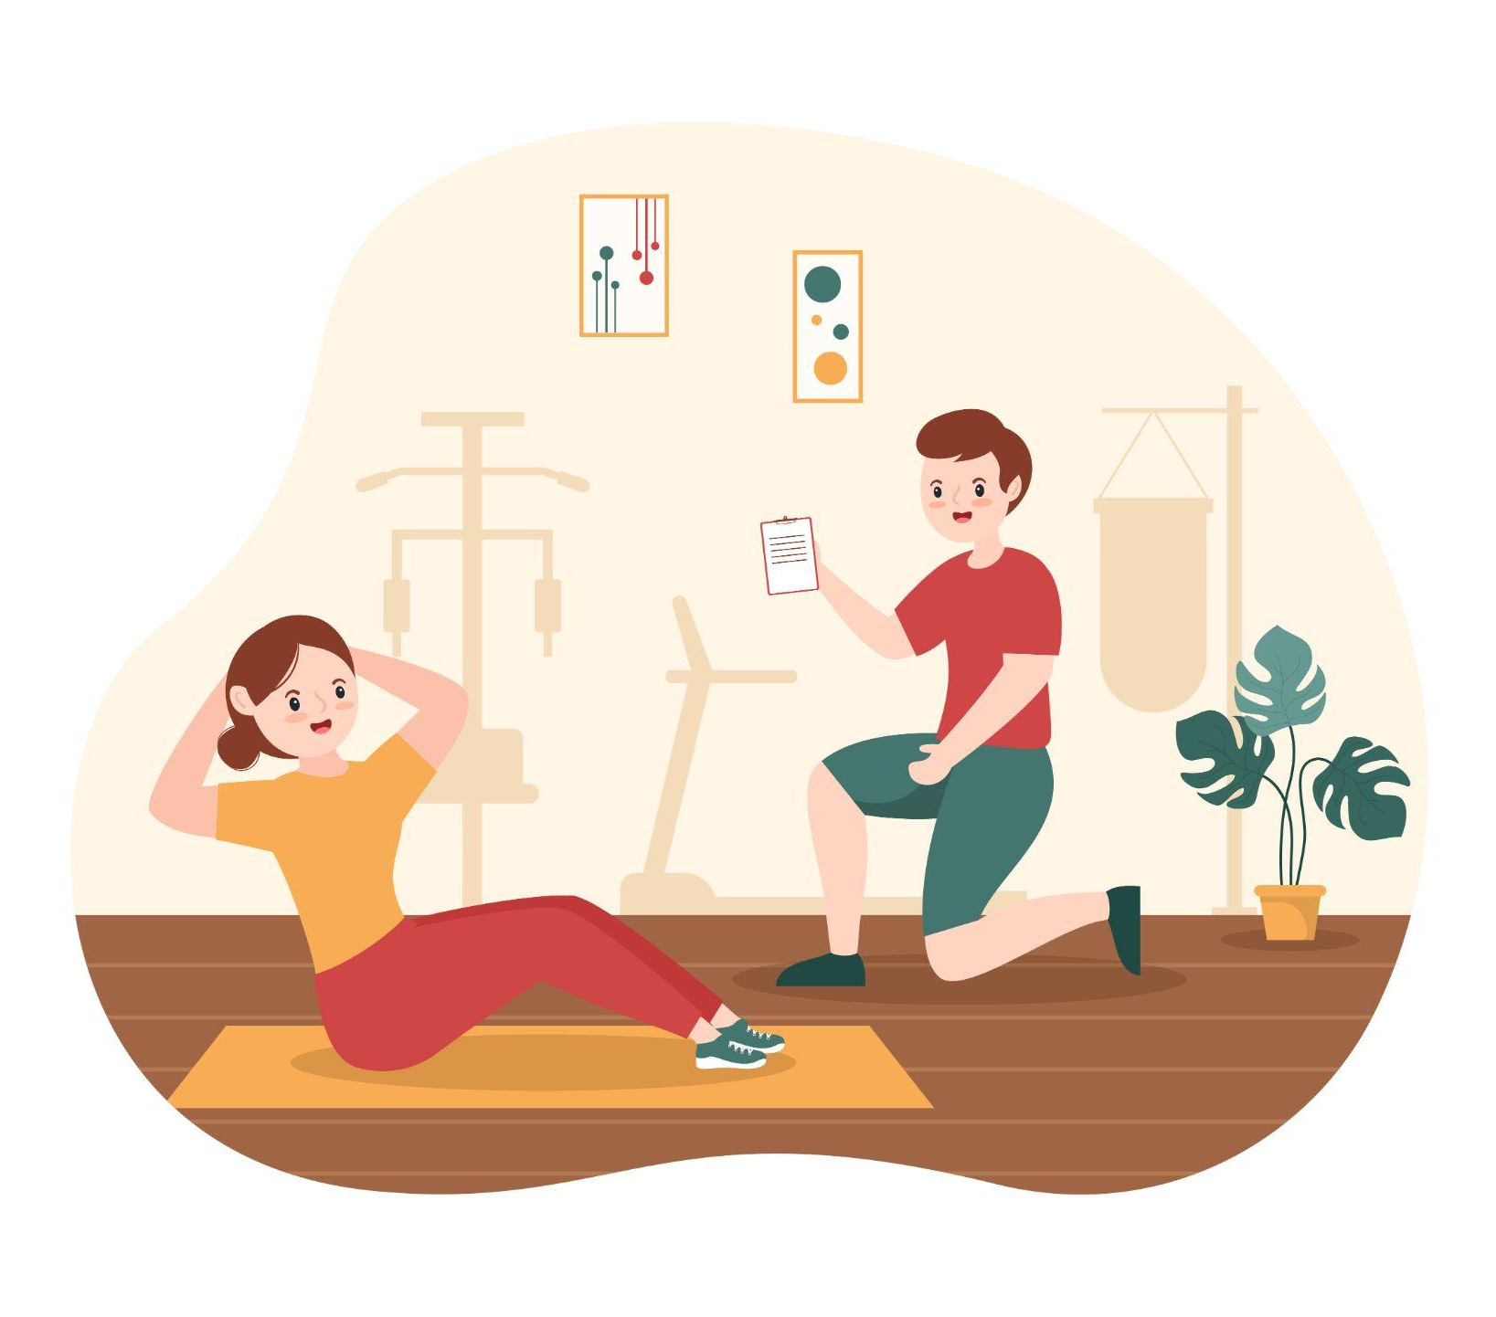
Developing Fitness
Guidelines for physical fitness:
Type of activity
Frequency
Duration
Intensity

Slide 9

Guidelines for Physical Fitness
Type of activity:
Cardio-respiratory (Aerobics) – Utilizes large muscles and can be maintained regularly such as walking, swimming, skiing, or running.
Frequency: 3-5 days/week
Duration: 20-60 minutes
Intensity: 55-90% of maximum heart rate

Slide 10
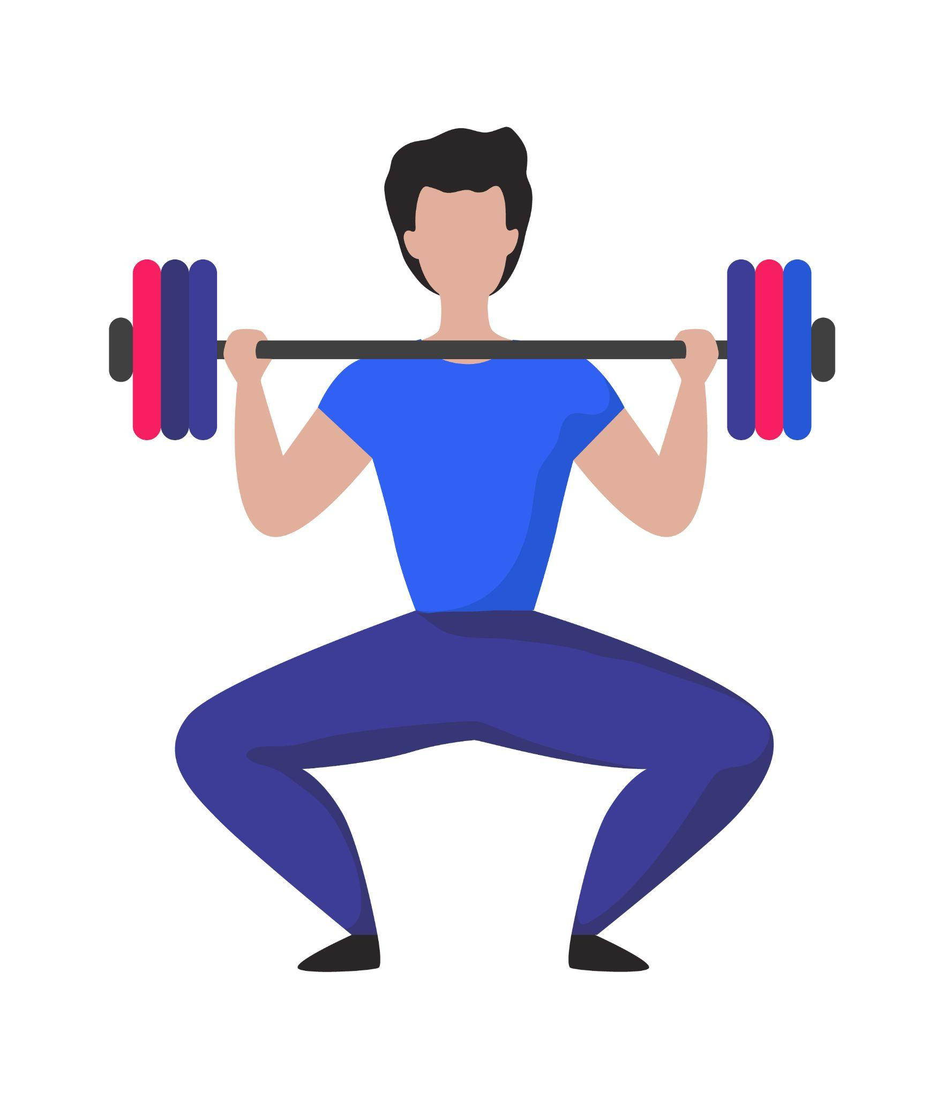
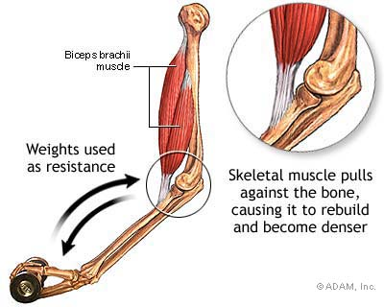
Guidelines for Physical Fitness
Type of activity:
Resistance (Strength) – performed at a controlled speed & through a full range of motion
Frequency: 2-3 days/week
Duration: enough to enhance muscle strength & improves body composition
Intensity: 8-12 repetitions of different exercises

Slide 11

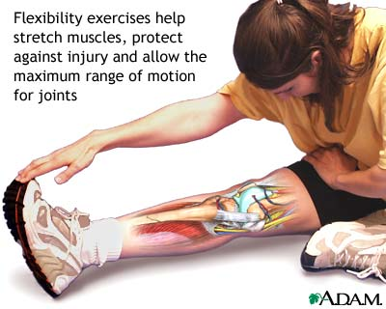
Guidelines for Physical Fitness
Type of activity:
Flexibility (Stretching) – activity that uses major muscle groups
Frequency: 2-3 days/week
Duration: enough to develop & maintain a full range of motion
Intensity: 4 repetitions of 10-30 seconds per muscle group

Slide 12
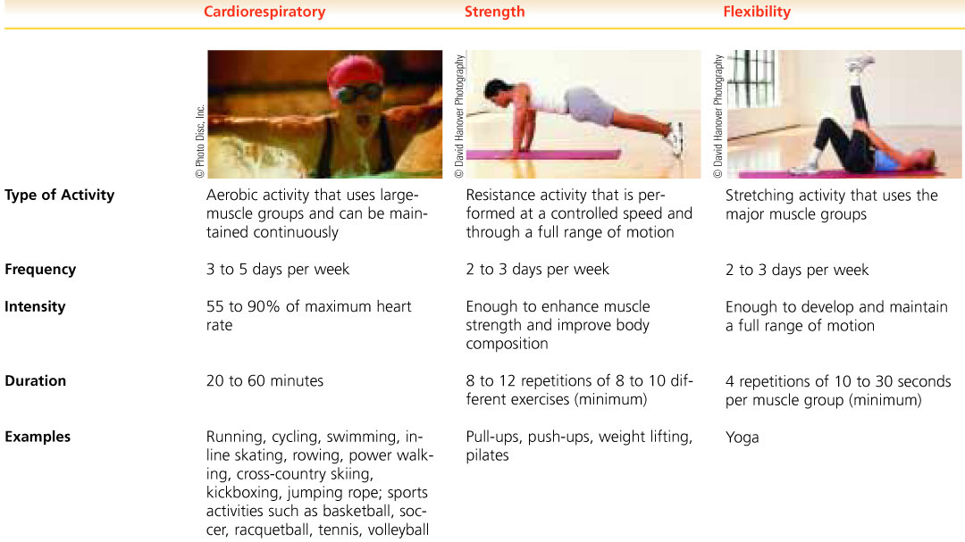
Guidelines for Physical Fitness

Slide 13
Levels of Physical Activity
Intensity Compared
Level of Intensity | Breathing and/or Heart Rate | Perceived Exertion (on a Scale of 0 to 10) | Talk Test | Energy Expenditure
Light | Little to no increase | <5 | Able to sing | <3.5 kcal/min
Moderate | Some increase | 5 or 6 | Able to have a conversation | 3.5 to 7 kcal/min
Vigorous | Large increase | 7 or 8 | Conversation is difficult or "broken" | >7 kcal/min
SOURCE: Centers for Disease Control and Prevention, www.cdc.gov/physicalactivity/everyone
updated March 30, 2011.
Notes:
Table 14-1 Levels of Physical Activity Intensity Compared

Slide 14
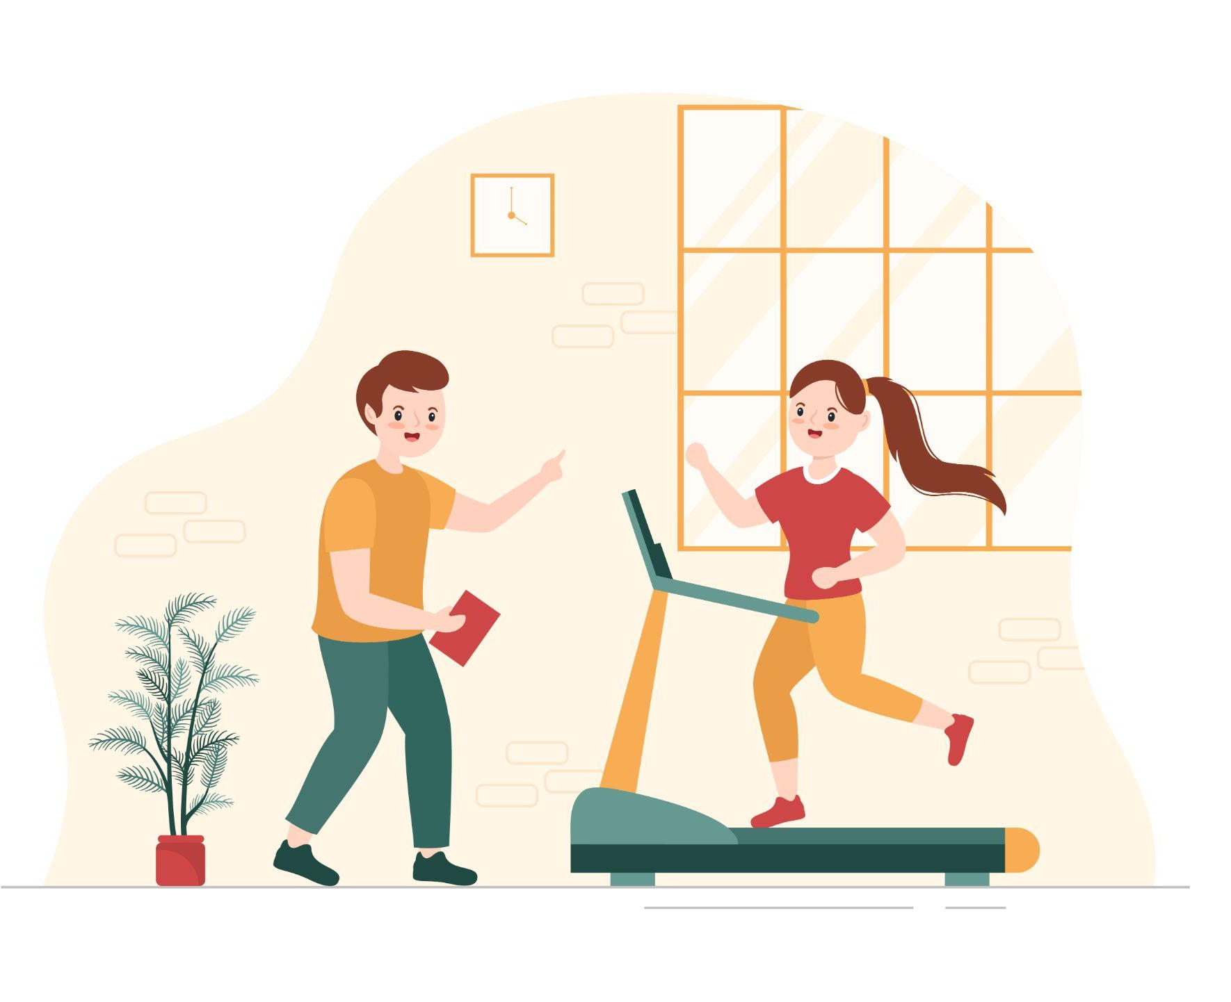
Physical Activity and Calories
Light aerobic exercise (<5 calories/minute): baseball, walking, golf
Moderate aerobic exercise (5-10 calories/minute): basketball, football, aerobics, running, swimming, weight training, tennis
Moderate to heavy aerobic exercise (>10 calories/minute): fast bicycling, rope skipping, running, skiing, fast walking

Slide 15
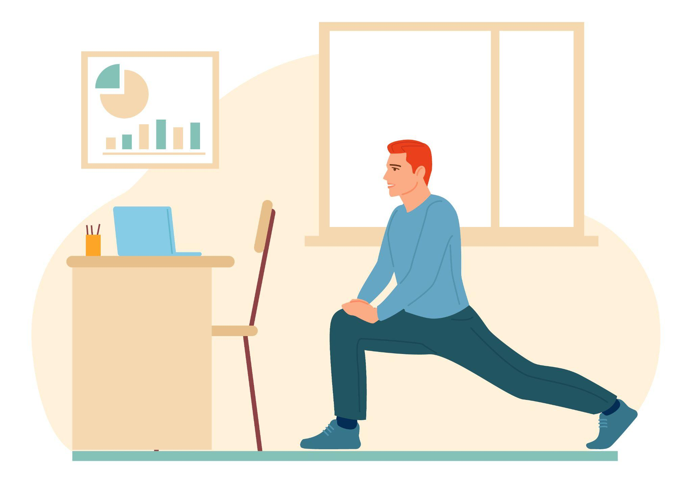
Key Recommendations
Engage in regular physical activity and reduce sedentary activities to promote health, psychological well-being, and a healthy body weight.
To reduce the risk of chronic disease in adulthood: Engage in at least 30 minutes of moderate-intensity physical activity, above usual activity, at work or home on most days of the week.
Greater health benefits can be obtained by engaging in physical activity of more vigorous intensity or longer durations.

Slide 16
Key Recommendations
To help manage body weight and prevent weight gain in adulthood:
Engage in approximately 60 minutes of moderate to vigorous-intensity activity on most days of the week while not exceeding caloric intake requirements.
To sustain weight loss in adulthood:
Participate in at least 60 to 90 minutes of daily moderate-intensity physical activity while not exceeding caloric intake requirements. Some people may need to consult with a healthcare provider before participating in this level of activity.
Achieve physical fitness by including:
Cardiovascular conditioning
Stretching exercises for flexibility
Resistance exercises or calisthenics (aerobics) for muscle strength

Slide 17
Key Recommendations
for Specific Population Groups
Children and adolescents:
Engage in at least 60 minutes of physical activity on preferably all days of the week.
Pregnant women:
In the absence of complications, incorporate 30 minutes or more of moderate-intensity physical activity on most, if not all, days of the week. Avoid activities with a high risk of falling or abdominal trauma.
Breastfeeding women:
Be aware that neither acute nor regular exercise adversely affects the mother's ability to successfully breastfeed.
Older adults:
Participate in regular physical activity to reduce functional declines associated with aging and to achieve the other benefits of physical activity identified for all adults.

Slide 18
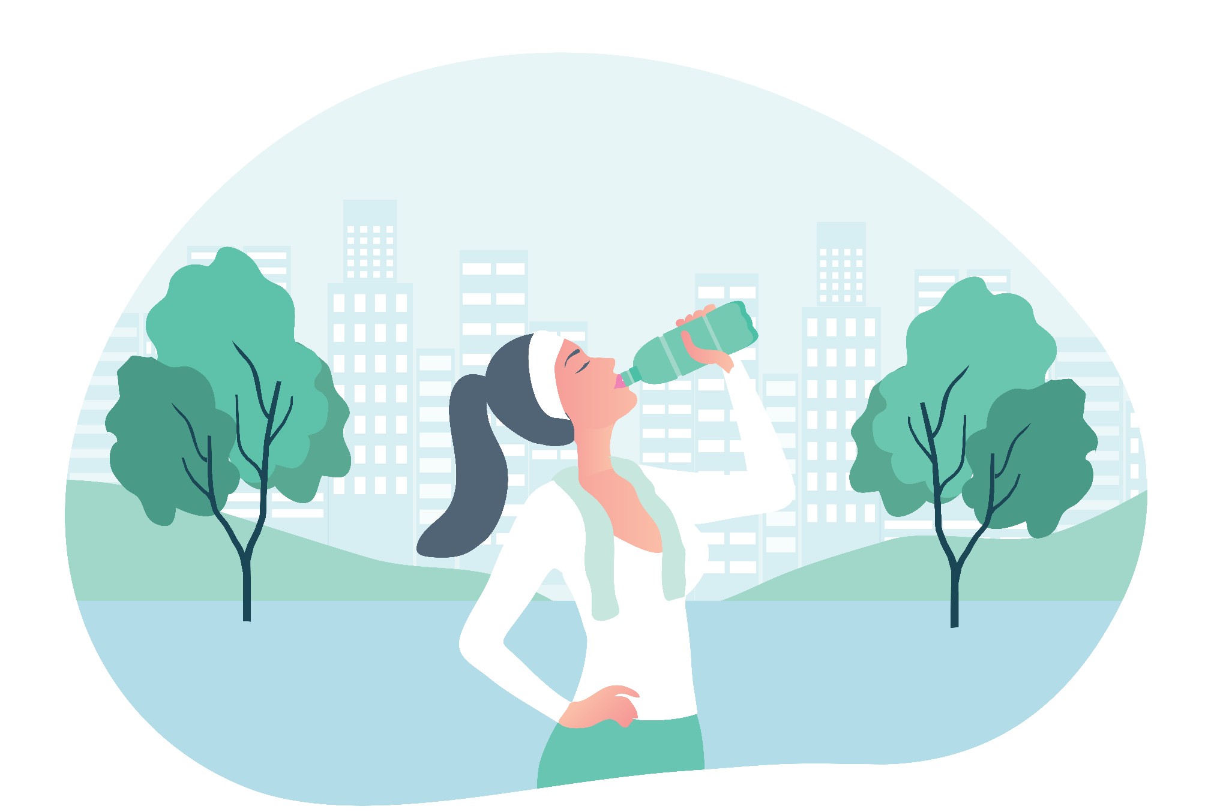
Water Intake
Physical activity increases the body’s need for water. People should drink in response to thirst, and consume enough water to replace the amount lost in sweat.
Rule of thumb:
2 cups of water 15-20 minutes before an event
~½ cup every 15 minutes during the event

Slide 19
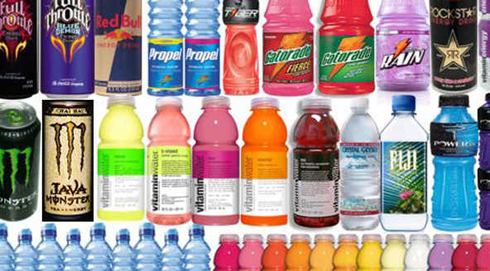
Sports Drinks/Fluid Replacers
Beverages that contain a weak solution of CHO, sodium, and other electrolytes appear to improve endurance and hydration status during prolonged, intense events that last > 1 hour.
Sports drinks may be consumed in addition to water and NOT as a replacement for water.

Slide 20

Steroids
Synthetic derivatives of the male hormone testosterone used in dangerous forms (syringes and pills) and doses.
Increases muscles and decrease fat mass
Increases muscle strength even without resistance training
Classified as controlled substances by the US Congress (like drugs)
Has many side effects on reproductive organs, the mind (aggression and hostility), heart, and blood cholesterol

Slide 21

Information
For Your Interest

Slide 22
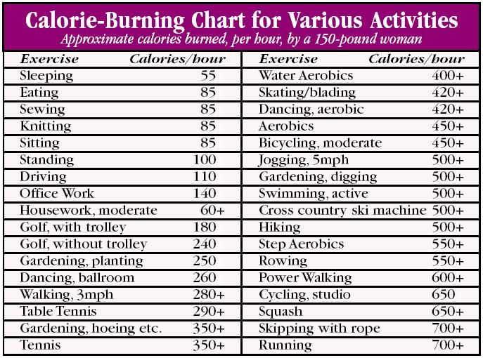
For Your Information Only

Slide 23
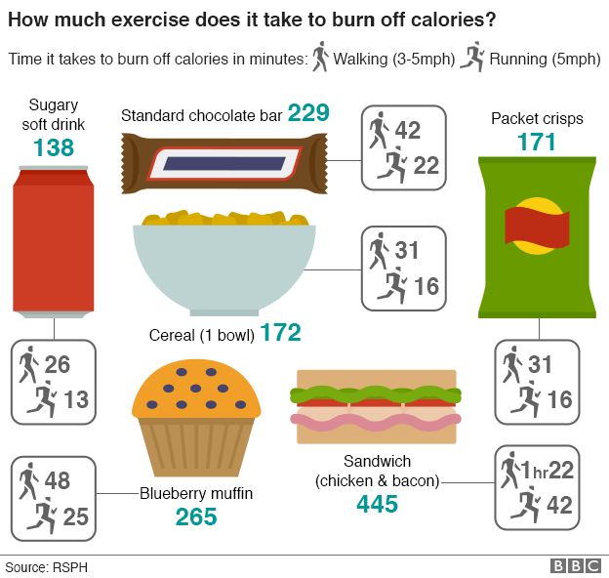
For Your Information Only

Slide 24
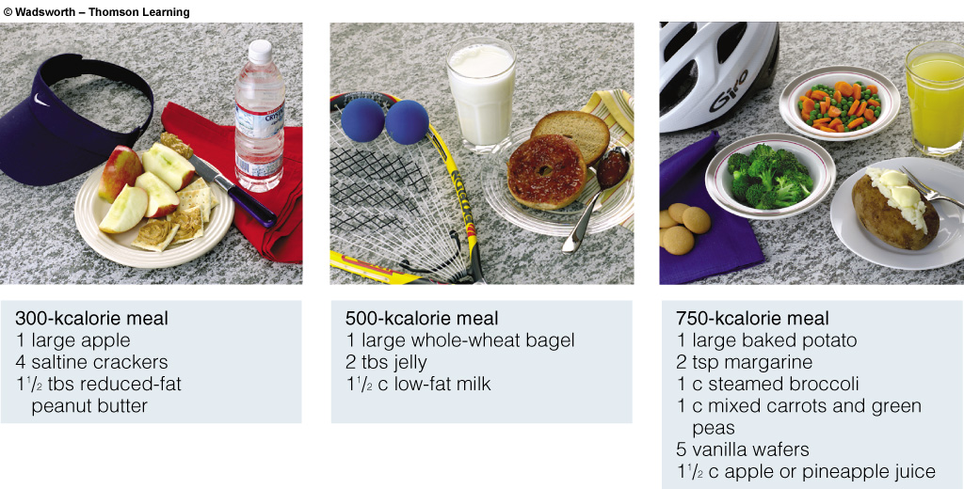
Pre-Game Meals

Slide 25
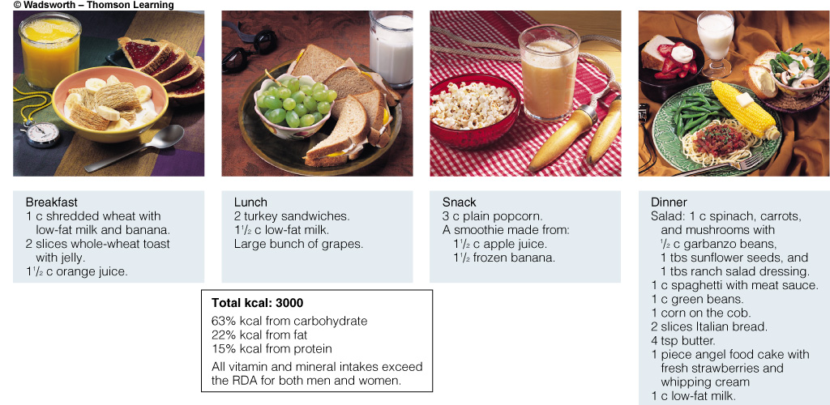
Choosing a Diet

Slide 26
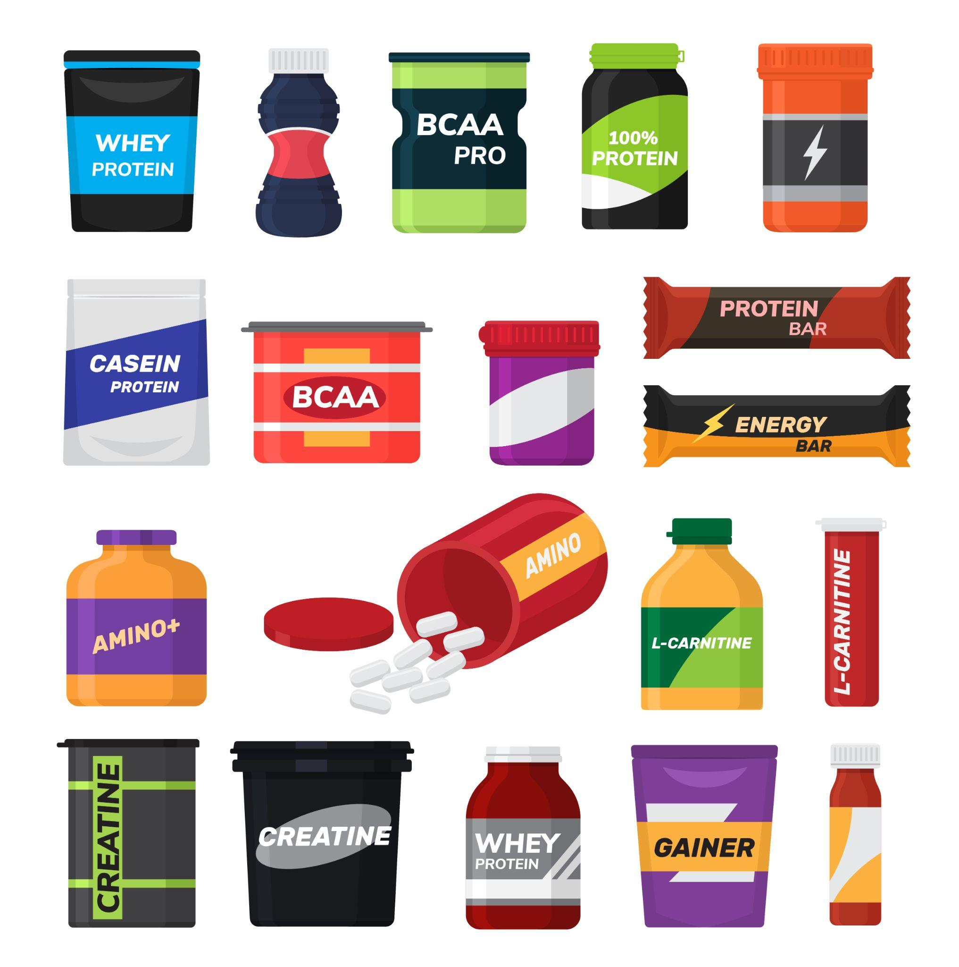
Supplements
Ergogenic aids
Protein powders OR adequate diet
Amino acid supplements
Creatine: Helps in fatty acid oxidation to release
Energy: Caffeine
Oxygenated water
Notes:
In the context of sport, an ergogenic aid can be broadly defined as a technique or substance used for the purpose of enhancing performance. Ergogenic aids have been classified as nutritional, pharmacologic, physiologic, or psychologic and range from use of accepted techniques such as carbohydrate loading to illegal and unsafe approaches such as anabolic-androgenic steroid use. The efficacy of many of these techniques is controversial, whereas the deleterious side effects are clear.

Slide 27
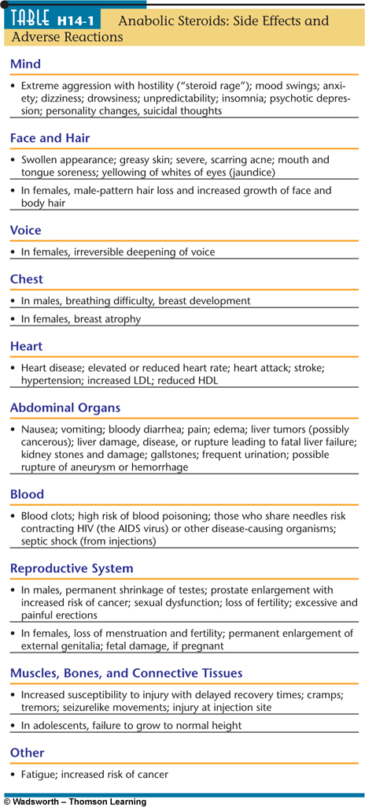
Anabolic Steroids:
Side Effects and Adverse Reactions

